Slide 1
Ransomware Defense for Small Organizations
2022 Capstone

Slide 2



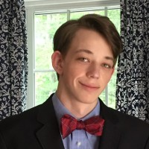
The Capstone Team
Louis Najdek
Colton Hulce
Tao Zimmerman
William Atwood

Slide 3
Abstract
The goal is to provide a ransomware defense guide to unsuspecting small/local businesses who are under great threat as ransomware attacks have risen in the past couple of years. This project may ideally help some small businesses protect themselves.

Slide 4
Defining Ransomware
Pay a ransom to remove malware and recover your data
Ransom is paid in cryptocurrency
First seen in 1989, except with much different technology
2015 - ransomware starting to target small/medium bizz instead of consumers

Slide 5
Ransomware Today
Named by IBM as the top threat type of 2021
Manufacturing outpaced finance and Insurance with cyberattacks
IoT is in the sights of threat actors
Higher ransom payouts than ever before
A single group was responsible for 37% of ransomware attacks dealt with by IBM in 2021

Slide 6
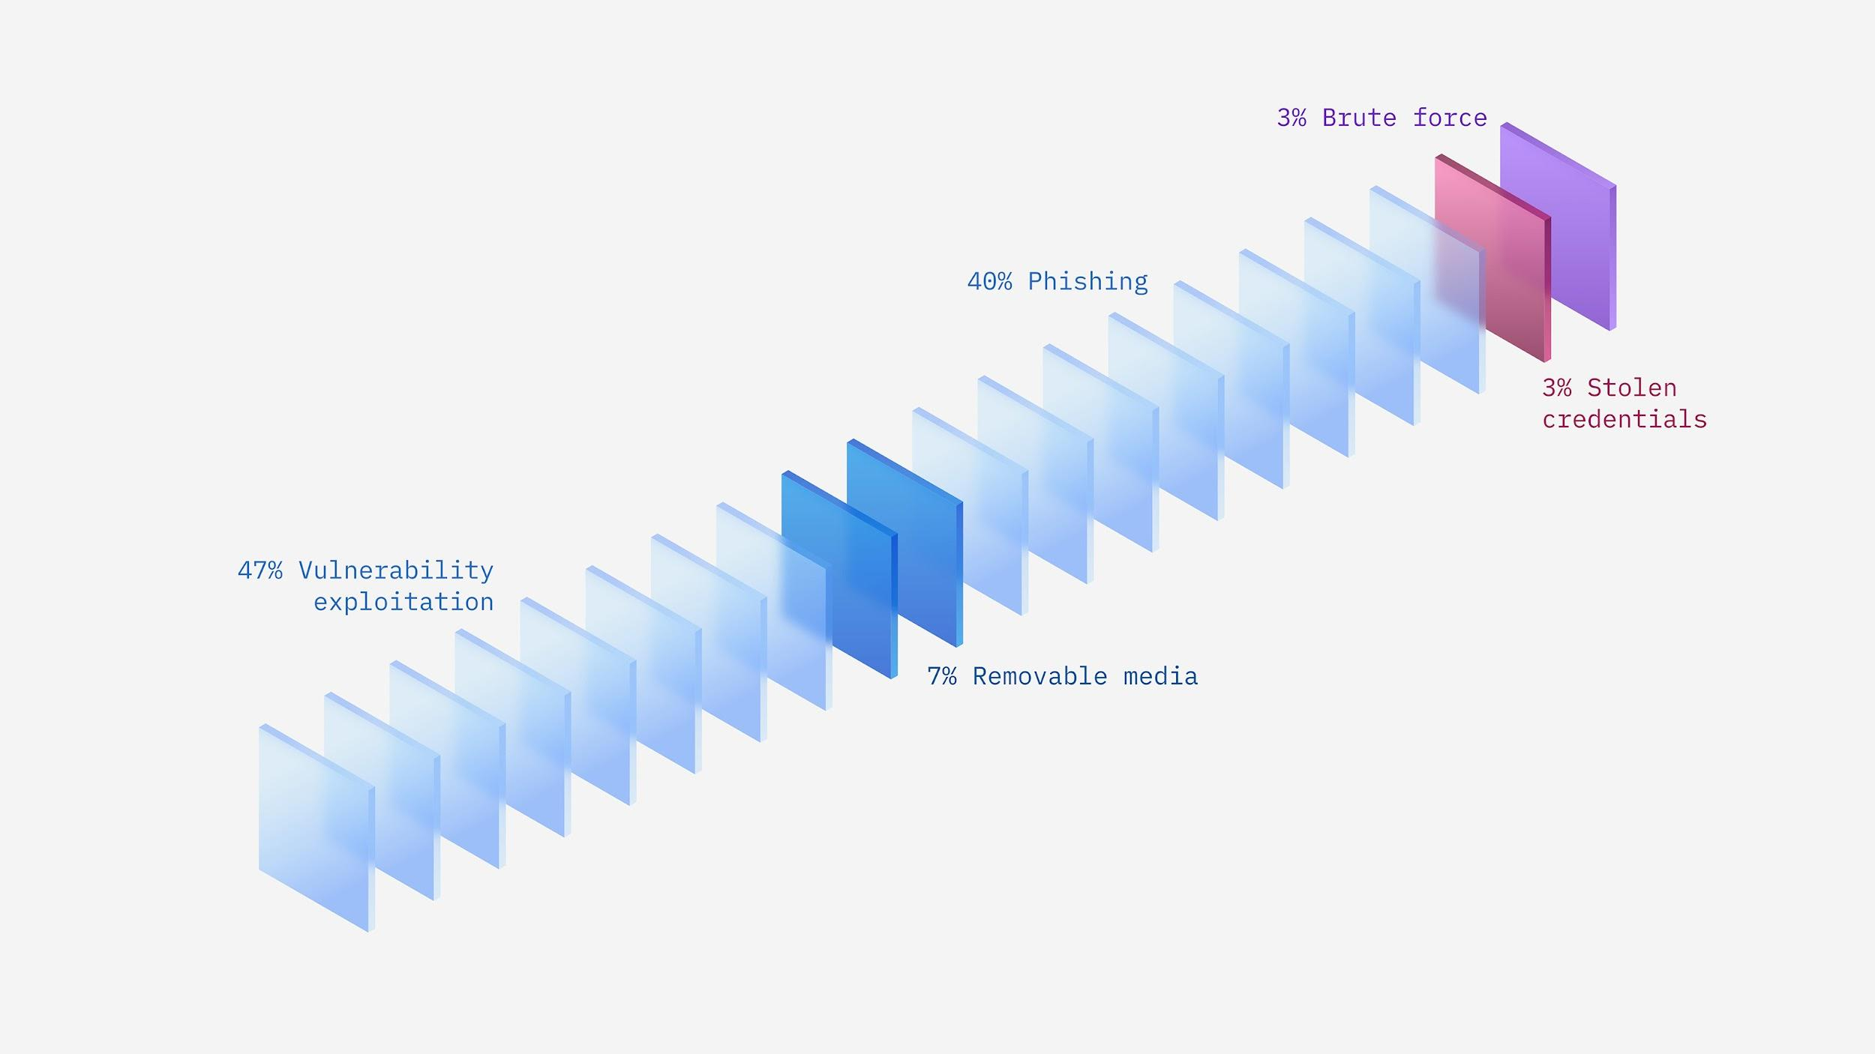
Top infection vectors for manufacturing
Source:https://www.ibm.com/security/data-breach/threat-intelligence/

Slide 7
Ransomware Today
Named by IBM as the top threat type of 2021
Manufacturing outpaced finance and Insurance with cyberattacks
IoT is in the sights of threat actors
Higher ransom payouts than ever before
A single group was responsible for 37% of ransomware attacks dealt with by IBM in 2021

Slide 8
Ransomware Today
(Cont.)
80% of organizations were hit by a ransomware attack in 2021. (Claroty x Forbes)
Experts estimated that a ransomware attack would take place every 11 seconds in 2021. (Cybersecurity Ventures)
At least one employee downloaded a malicious mobile application in 46% of organizations in 2021. (Check Point)
The total cost of a ransomware breach was an average of $4.62 million in 2021, not including a ransom. (IBM)

Slide 9
Capstone
Research…lots of research…
Final Product
End user video guide and info sheets
“System Administrator” video guide and info sheet

Slide 10
End User Guide
Section 1 - Introduction
Section 2 - Attack vectors
Phishing Emails
Downloads
Internal attacks
Section 3 - Response
Indicators of Compromise
Response Plan
Section 4 - Video Demonstration
Simulated Phishing attack

Slide 11
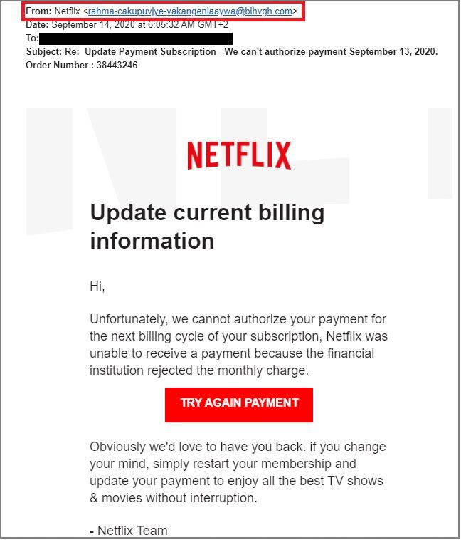
Phishing Example 1

Slide 12
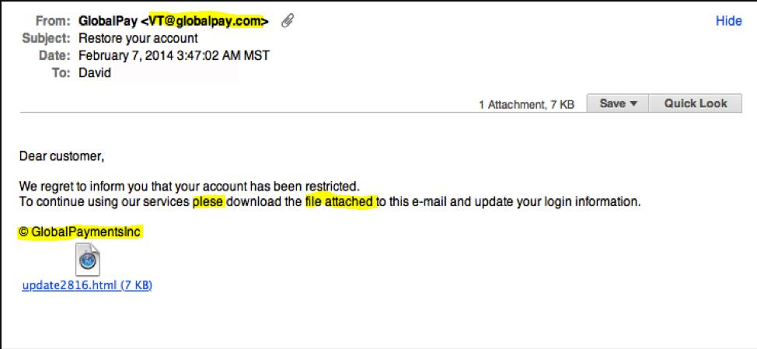
Phishing Example 2

Slide 13
End User Guide
Section 1 - Introduction
Section 2 - Attack vectors
Phishing Emails
Downloads
Internal attacks
Section 3 - Response
Indicators of Compromise
Response Plan
Section 4 - Video Demonstration
Simulated Phishing attack

Slide 14
System Administrator Guide
Section 1 - Backups
Section 2 - End-User Training and Awareness
Section 3 -Maintaining services and utilizing anti-virus programs
Section 4: Segmentation and Least Privilege
Section 5: Additional Strategies
Section 5.1: Penetration Testing
Section 6: Response

Slide 15
References
IBM. IBM Security X-Force Threat Intelligence Index. 23 Feb. 2022, https://www.ibm.com/security/data-breach/threat-intelligence.
“73 Ransomware Statistics Vital for Security in 2022.” Panda Security Mediacenter, 4 Mar. 2022, https://www.pandasecurity.com/en/mediacenter/security/ransomware-statistics/.
Updated: 2022-03-22T15:09:32+00:00, Aleksandar Kochovski-Last. “Ransomware Statistics, Trends and Facts for 2022 and Beyond.” Cloudwards, 27 July 2021, https://www.cloudwards.net/ransomware-statistics/.
REvil/Sodinokibi Ransomware. https://www.secureworks.com/research/revil-sodinokibi-ransomware.

Slide 16
William Atwood
Computer Networking and Cybersecurity 2022
William.atwood917@gmail.com
https://www.linkedin.com/in/william-atwood-4b765316a

Slide 17
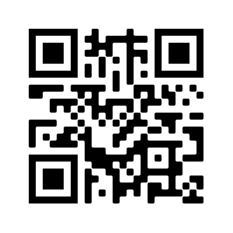
ITS CONFERENCE GIVEAWAY

